Slide 1
Artificial Intelligence in Medicine: Revolutionizing Healthcare
Roman Suvorov, S. S. Adanenko, Artem Gnevkov

Slide 2
Искусственный интеллект в медицине: революция в здравоохранении
Суворов Роман, Аданенко С. С., Гневков Артём

Slide 3
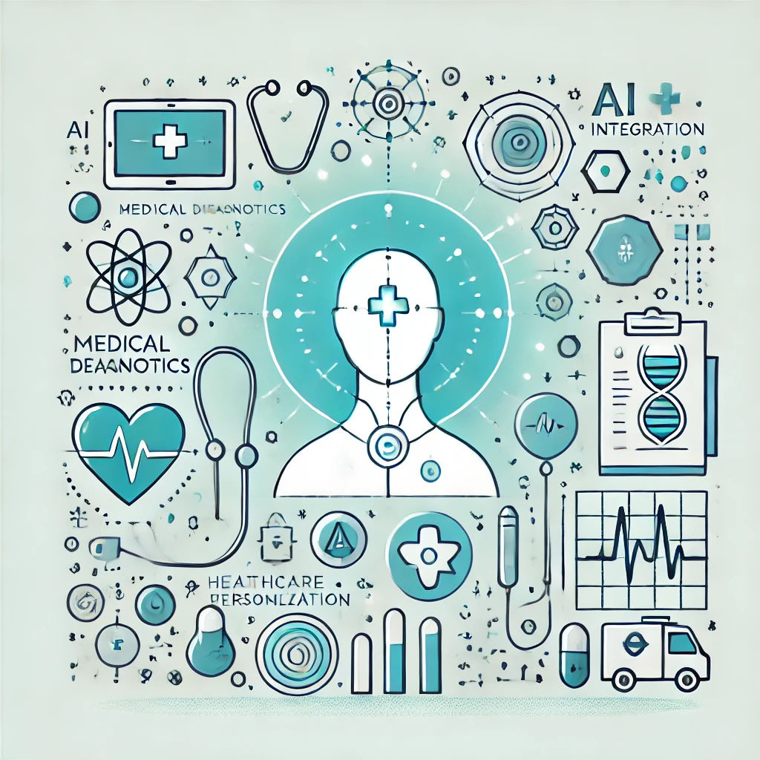
Introduction - AI in Medicine
Artificial Intelligence (AI) helps analyze data, diagnose, and predict outcomes.
Enhances precision and personalization in medicine.

Slide 4
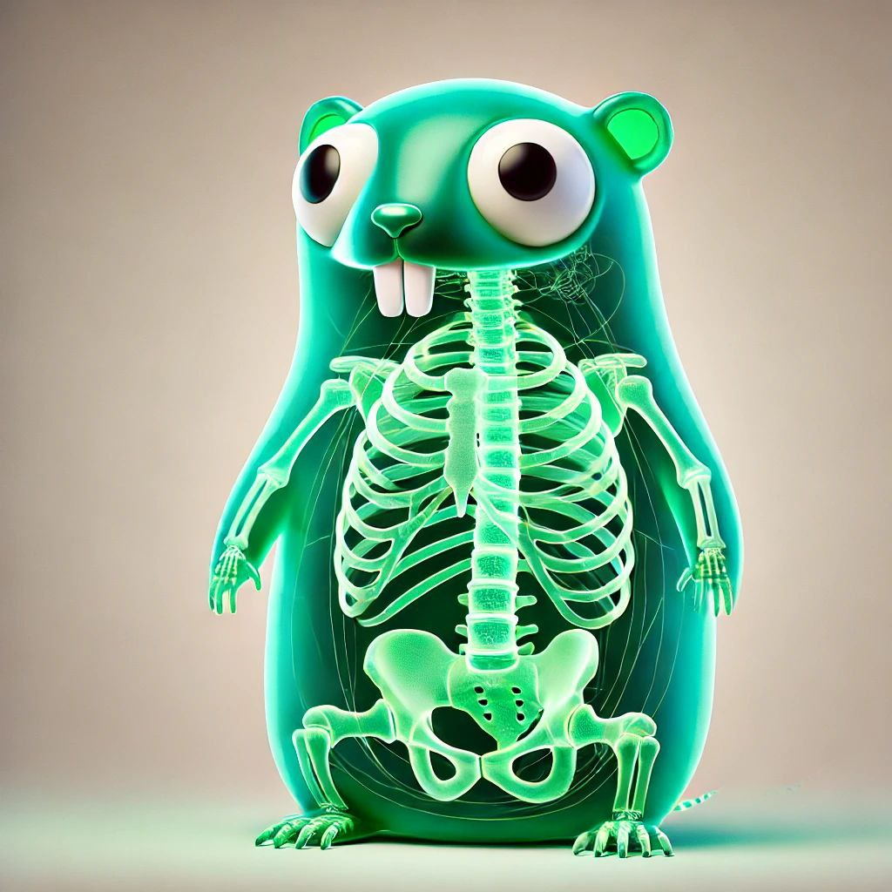
AI in Diagnostics
AI analyzes medical images (X-rays, MRIs, CT scans).
Detects diseases at early stages (e.g., cancer, cardiovascular conditions).
Provides fast and accurate diagnostics.

Slide 5
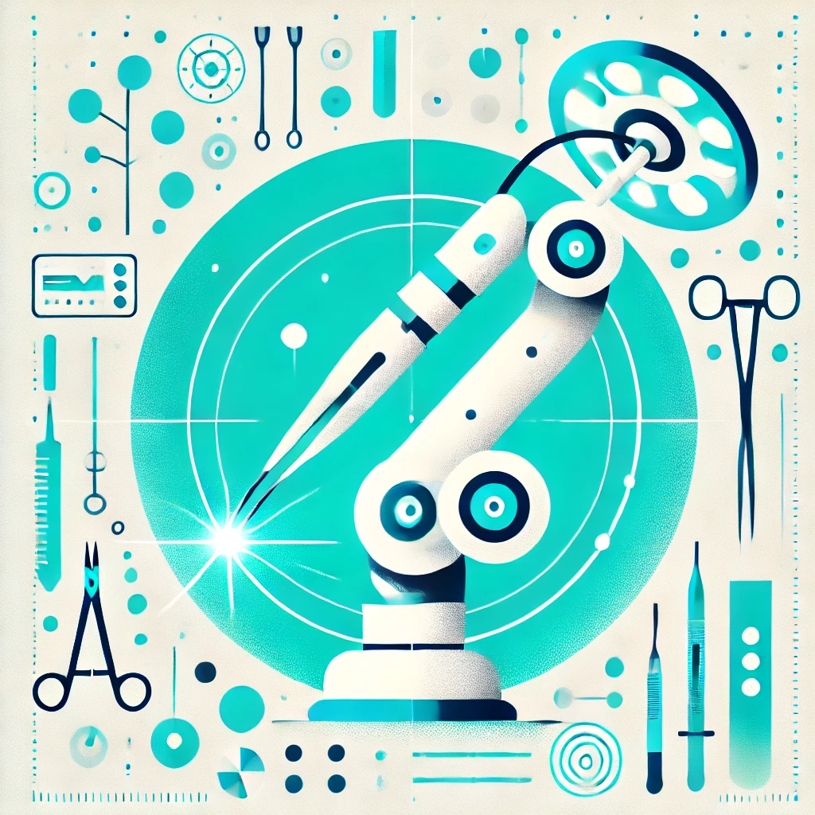
Surgery and Trauma Care
AI-powered robots enhance surgical precision.
Minimally invasive procedures and adaptation to anatomy.
In trauma care — rapid data processing for prioritized treatment.

Slide 6

Personalized Medicine
Analyzes medical and genetic data.
Recommends individualized treatment plans.
Optimizes therapies and reduces side effects.

Slide 7

Predictive Analytics
Identifies patients at risk for chronic diseases.
Enables early diagnosis and prevention.
Improves long-term health outcomes.

Slide 8
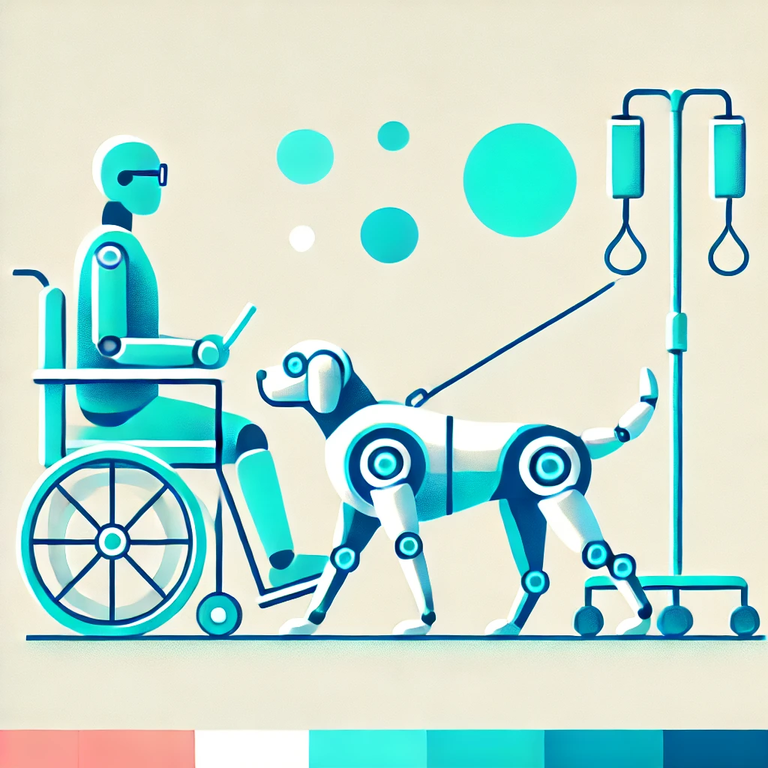
AI in Rehabilitation
Virtual assistants for post-surgery rehabilitation.
Tracks progress and adapts treatment plans.
Accelerates recovery and reduces burden on healthcare staff.

Slide 9

Conclusion
AI is revolutionizing diagnostics, surgery, and rehabilitation.
Enhances precision, personalization, and healthcare efficiency.
Holds great potential for global health improvement.

Slide 10
Questions
What medical imaging techniques does AI analyze to detect diseases like cancer?
Which medical fields benefit from AI-powered robotic systems in surgery?
How does AI improve recovery rates in personalized medicine?
What chronic conditions does AI help identify at-risk patients for?
How does AI assist patients in rehabilitation programs?

Slide 11
Answers
1. X-rays, MRIs, and CT scans
2. Orthopedics, cardiology, and neurosurgery
3. By analyzing medical and genetic data to recommend tailored treatments, selecting optimal therapies, and reducing side effects
4. Diabetes and heart disease
5. Through virtual assistants and programs that help perform exercises, track progress, and adapt treatment plans based on their condition

Slide 12






Thank You for Your Attention!

